Slide 1




Smart Product Comparison Platform
Compare prices, Ratings, and deals across Amazon & Flipkart Presented by: Hirak Nath ,Prem Kumar and Shubham Kumar

Slide 2

Why Do We Need a Comparison Platform?
Shoppers waste time browsing multiple e-commerce websites
Prices vary across platforms for the same product
No single place to compare ratings, reviews, and offers
Missed opportunities due to lack of price prediction

Slide 3
Introducing Our Comparison Web App
Shows scraped price, rating, name, and URL for a product
Covers Amazon and Flipkart (will be expandable to others)
Displays side-by-side comparisons in one dashboard
Integrated price drop prediction meter

Slide 4
How It Works: User input → Data Extraction → Comparison Table + Prediction
Search query entered by user
Collects required data from the database.
Cleaned and structured into tables
Optional display of a price prediction analyser(price-drop predictor)

Slide 5
Tech Stack
Frontend: HTML, CSS, JavaScript
Backend: Python (Flask)
Concurrency: Multithreading for speed
Prediction Model: (Taken from Buyhatke)
Data Export: Excel/CSV support

Slide 6

Price Drop Prediction Meter
Predicts chances of a price drop in the next few days
Uses recent price trend analysis (e.g., Buyhatke)
Helps users time their purchases better
Simple and intuitive UI

Slide 7
Why Users Will Love It
Saves time by eliminating manual comparisons
Increases savings by finding best prices
Informed buying decisions using ratings & predictions
One-stop platform—no more switching tabs

Slide 8
What’s Next?
Add
Add more platforms: Snapdeal, Shopsy, etc.
Add
Add product categories(fashion,headphones,gadgets)
Integrate
Integrate user login and wishlist tracking
Improve
Improve User Experience and UI

Slide 9
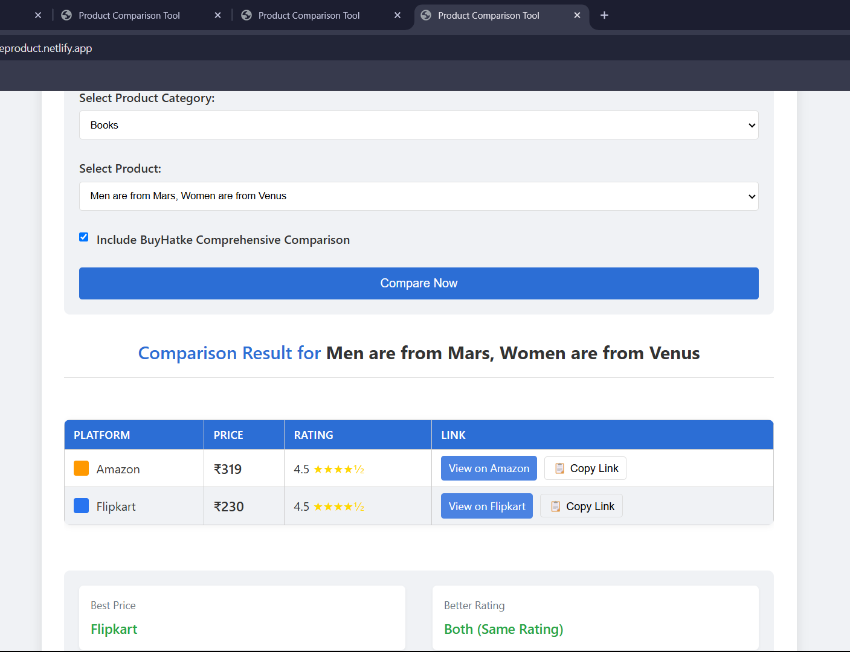
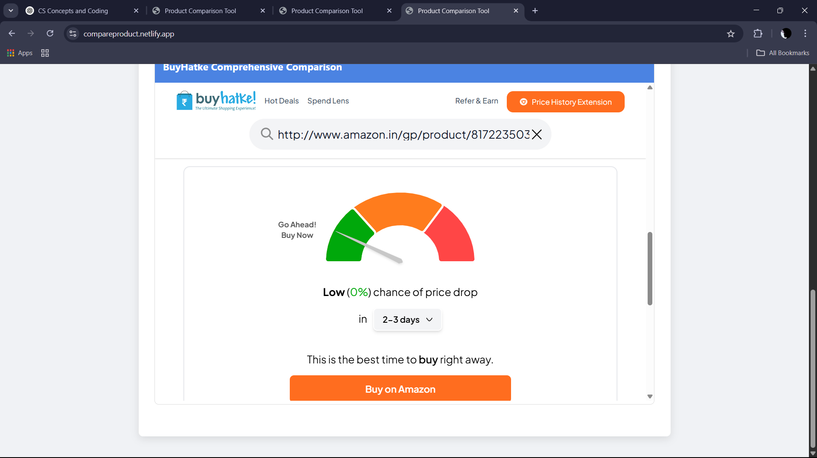
Live Demo or Screenshots

Slide 10

Thank You!

